Slide 1
Orbit intelligence training
User seminar – 28 February – Moscow

Slide 2
Search session

Slide 3
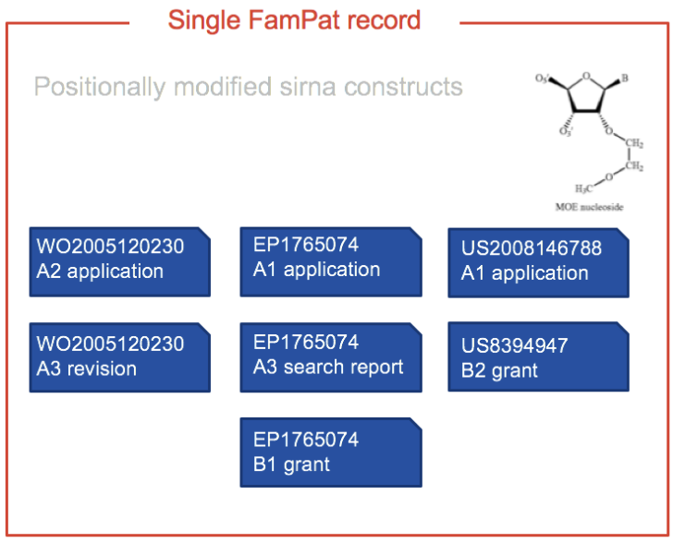
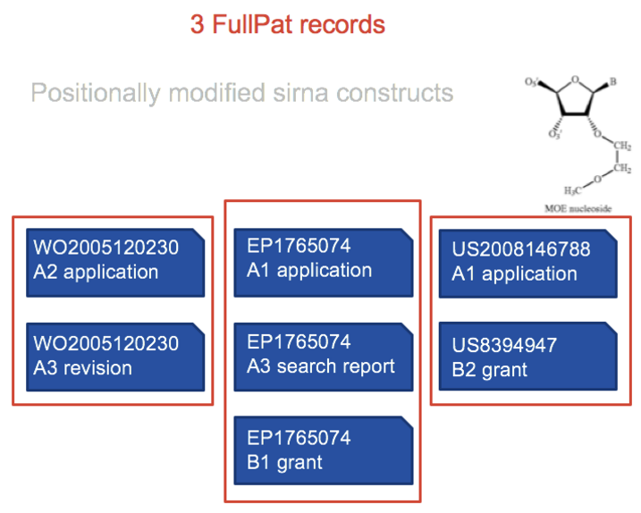
Patent Families vs. Patents
FamPat: Patents protecting the same invention in different countries are grouped in a family
FullPat: Patents protecting the same invention in different countries are individual records

Slide 5
FTO search
Preferred database: FullPat
➔ Better to focus on individual countries
➔ Native language when possible
Limitation:
Legal status: Only alive patents can block you
➔ Advice: choose “Alive” (but be careful with lapsed publications)
Validity date of the patents: if the patent is lapsed/dead/expired, you are typically free to operate
➔ Advice: choose “Priority date” and search “21 years ago to present”
Specific geographic areas: where you are trying to determine FTO
➔ Advice: consider searching by country level for clearance in a particular country
Field: claims characterize and limit the scope
➔ Advice: choose “Claims”

Slide 6
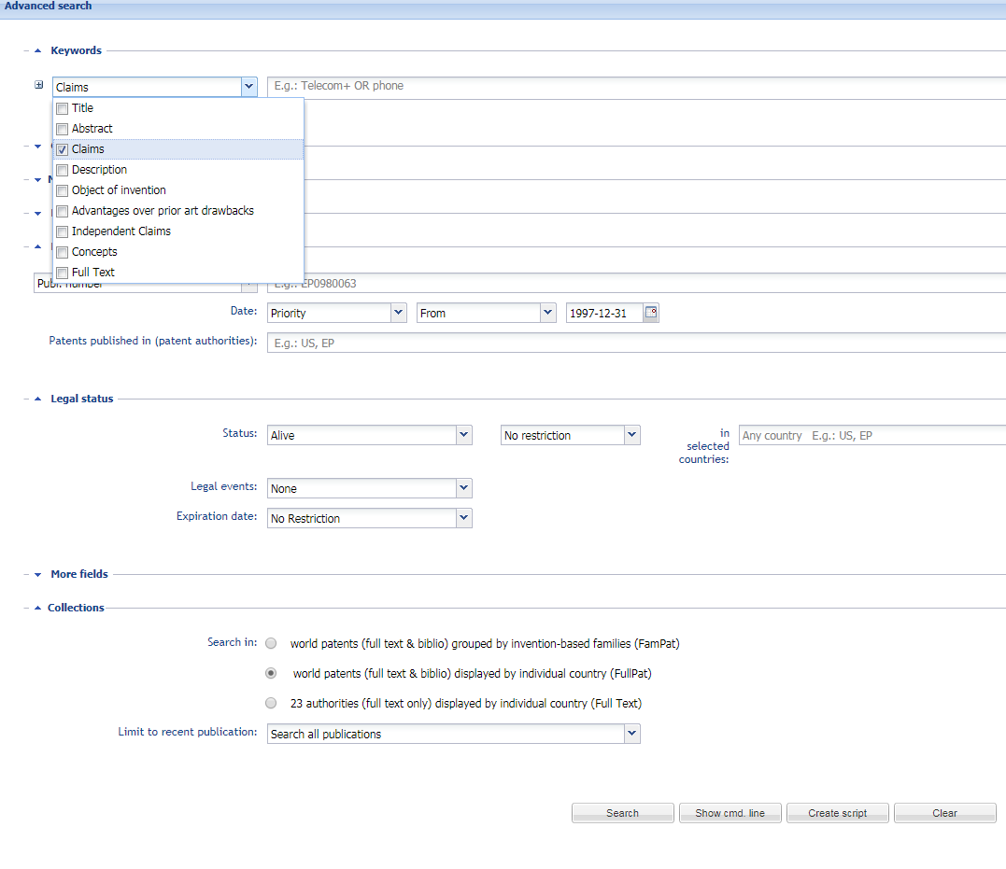
Field Limitation: Claims Patent validity limitation: Preceding 21 years Legal State and geographic limitation: Alive and a specific country Search by publication: FullPat database

Slide 7
Patentability search
Preferred database: FamPat
➔ faster review: no duplicates
Limitation:
No date limit: any prior art can block you
➔ Advice: choose “Alive or Dead” and search “All publications”
No geographic limit: any prior art can block you
No Field limitation: any prior art disclosed in the description is sufficient to destroy novelty, does not need to be in claims to block you
➔ Advice: use “Full Text”

Slide 8
No field limitation:
Full Text
No geographic
limit
No date limit:
All publications, Alive or Dead
Search by
invention:
FamPat database

Slide 9
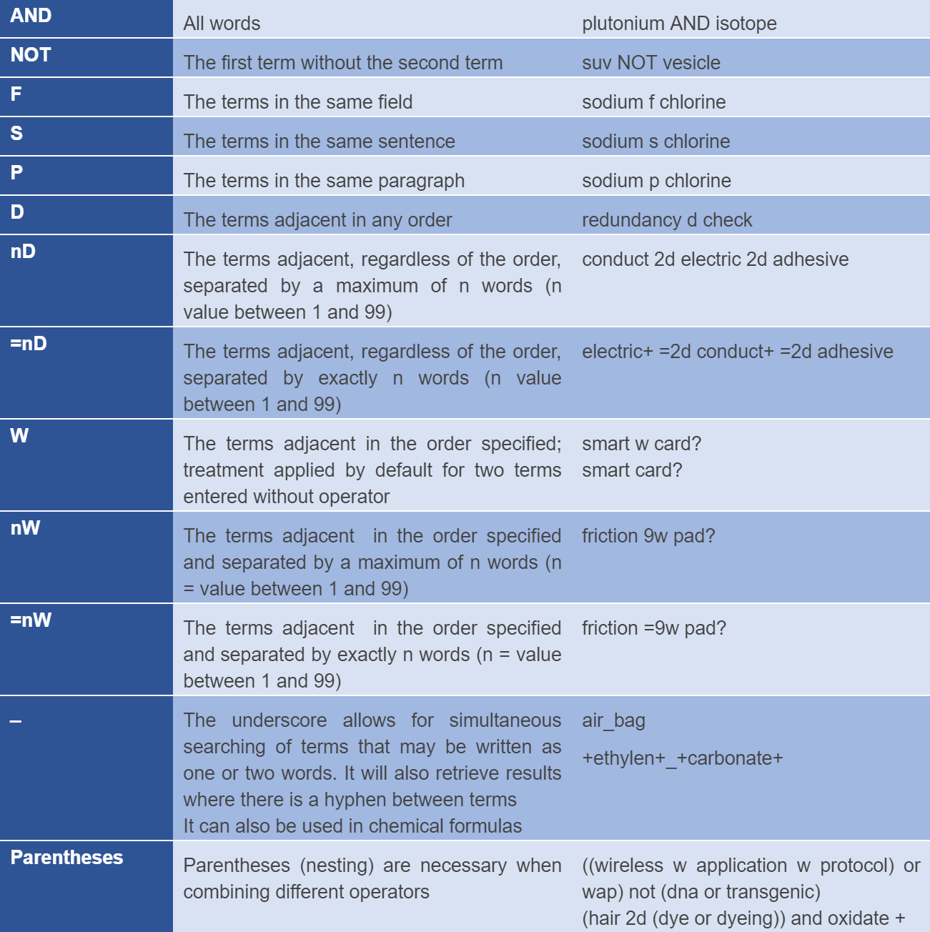
Operators

Slide 10
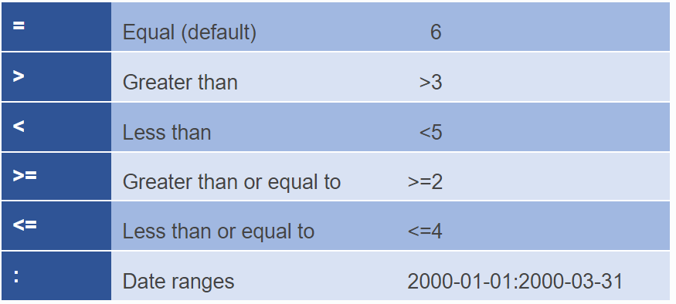
Truncations and Numeric Operators

Slide 11
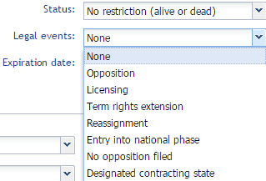
Status :
Legal Events :
Expiration Date:
Legal status
Search

Slide 12
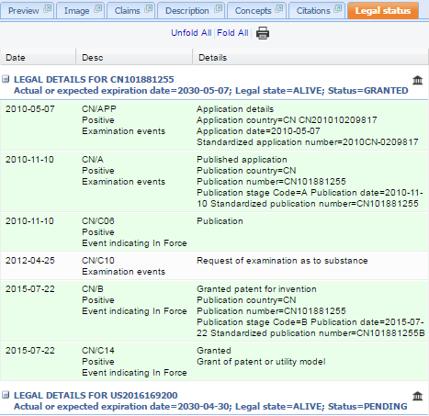
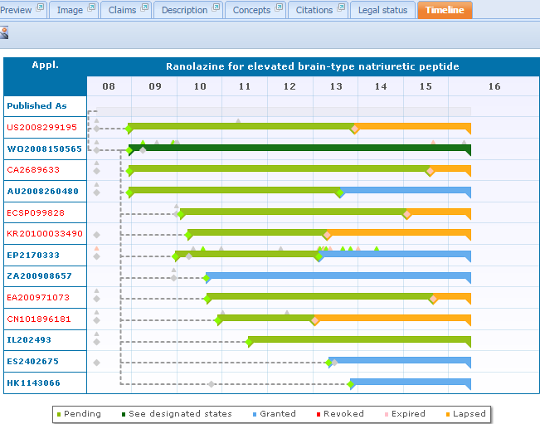
Legal Status tab:
Link to the IP register
Timeline:
Legal status
Display

Slide 13
Collections FamPat, FullPat, Fulltext
Avaliable collections are FamPat, FullPat and Fulltext
Check your user settings to ensure that you can search all available collections
Go to account menu: then and
: choose the option YES
then Confirm.
3 collections are now available in the advanced search.

Slide 14
Exercise 1 Select collection and search
How many patents contain the phrase Artificial Intelligence in the Title or abstract in Fullpat?
Notes:
Results:27933

Slide 15
Exercise 2 Combine keywords, country and legal status
How many alive patent families contain the phrase Artificial Intelligence in the Title or abstract and have been published in Russia?
Notes:
Results:762

Slide 16
Exercise 3 Combination of search steps
How many patent families contain the word LiFePO4 in the object of the invention but NOT in the abstract of patent families?
Notes:
Results: 210

Slide 17
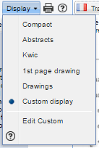
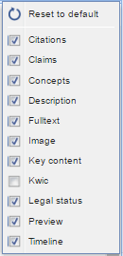
Customize hitlist display
Display the Preview tab to customize
Selection the tabs to display
Automatic sorting of results by relevance
Representative member
(from user settings)
Results Display
Customization

Slide 18
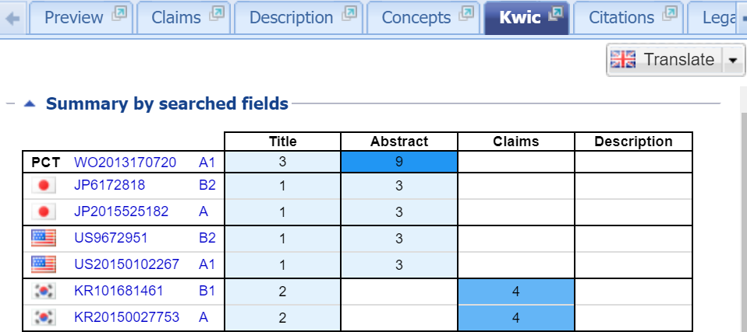
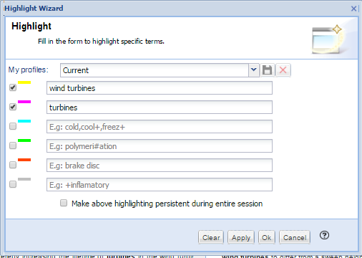
Tab KWIC (Key Word In Context) : to display the distribution in the family of terms searched on the basis of the search fields
Highlighting :navigate through the tabs, possibility of adding highlighted words, ability to save the highlight.
Results Display
KWIC, highlight

Slide 19
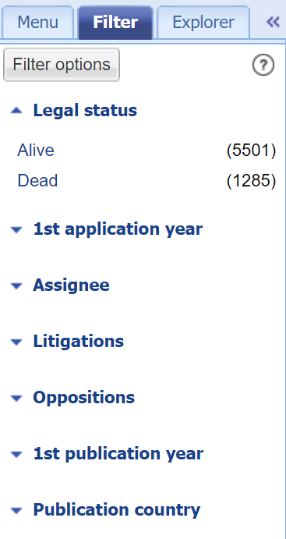
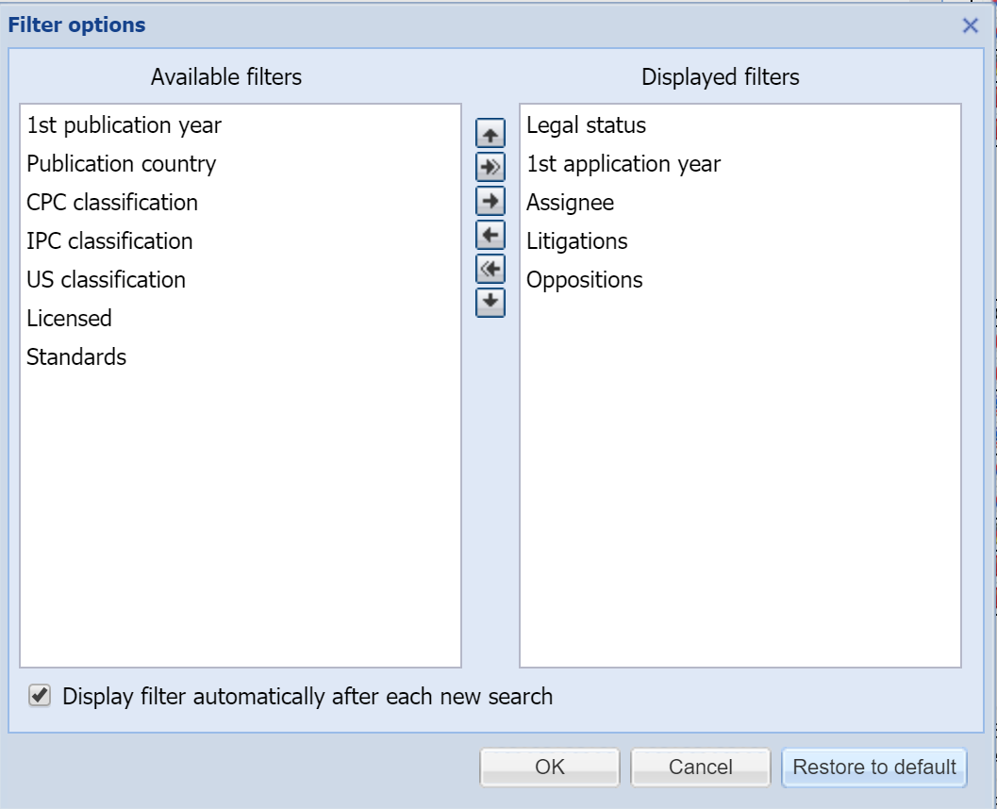
Results Display
Filter and view document
Filter: three options by default, possibility to add others, allows to filter the result of a search
View document: allows clicking on the title to view a particular family and focus on claims of a member, for example.
allows to view again the result list

Slide 20
Exercise 4 Identify litigated patents
Search for Driverless vehicles in Titles, Abstracts, objects and claims (Fampat).
How many patent families are litigated in the Driverless vehicles domain?
Identify two litigated patent members in the patent family owned by Waymo
Notes:
4
US5910382
US6514640
US2007117019

Slide 21
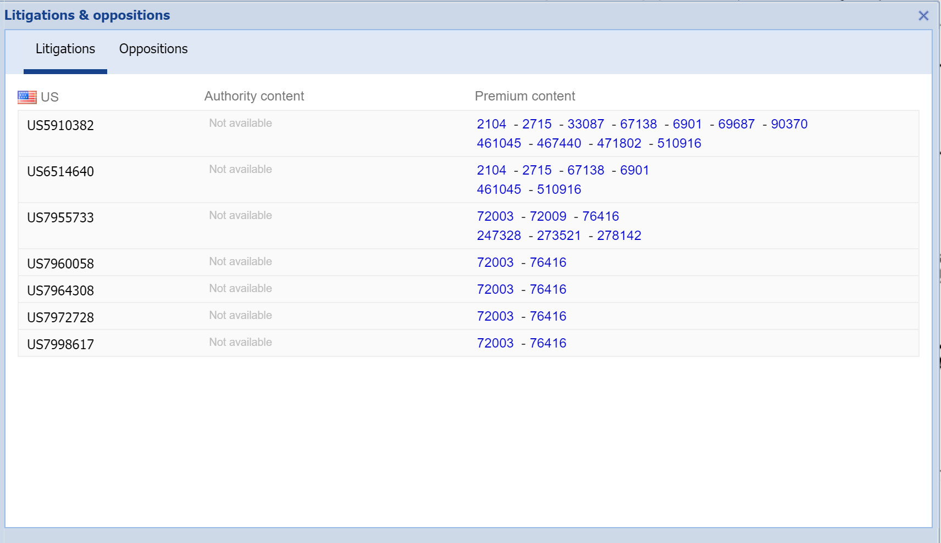

Slide 22
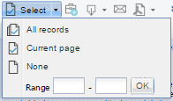
Selection
Selection button:
Click all records button to select the entire families
Check box at the top of the results list selects the current page
Number of selected families indicated

Slide 23
Research Tools
Similarity
Selection of one or several families (up to10 000)
1st option : to find similar patents in all database
2nd option : to find similar patents only in the results of the selection list
List organized by relevance: relevance score display
Using the KWIC tab to determine similar values of each families
Used to define new keywords, new classes…
Cross with other questions to refine
Similarity calculated on: similar concepts, similar classifications and citations.

Slide 24
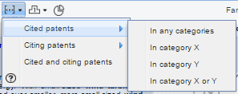
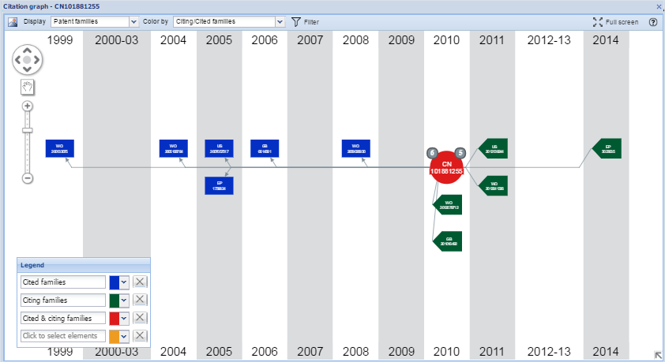
Research Tools
Citations
- Selection of one or several families (up to10 000)
Allows to find the cited families (prior art) /cited (applications) on the basis of the categories of relevance (examiners and applicants)
Citations Tab: display of citations (citing, cited) examiners and applicants, literature cited for a family. Possibility to display this information graphically by clicking on

Slide 25
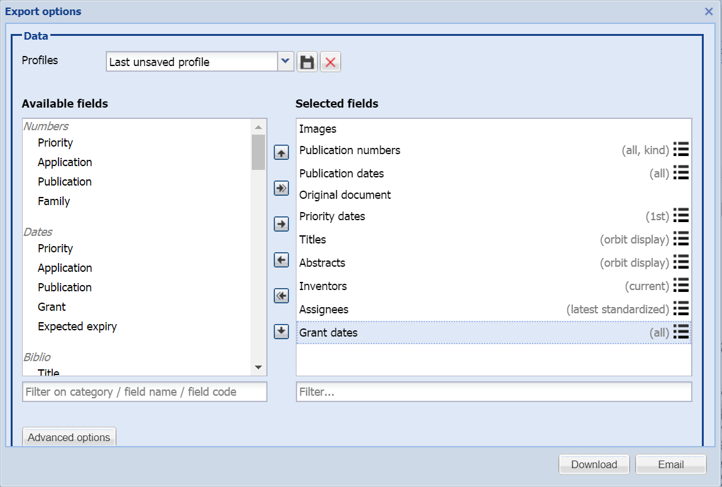
Save
Export Menu
XLSX

Slide 26
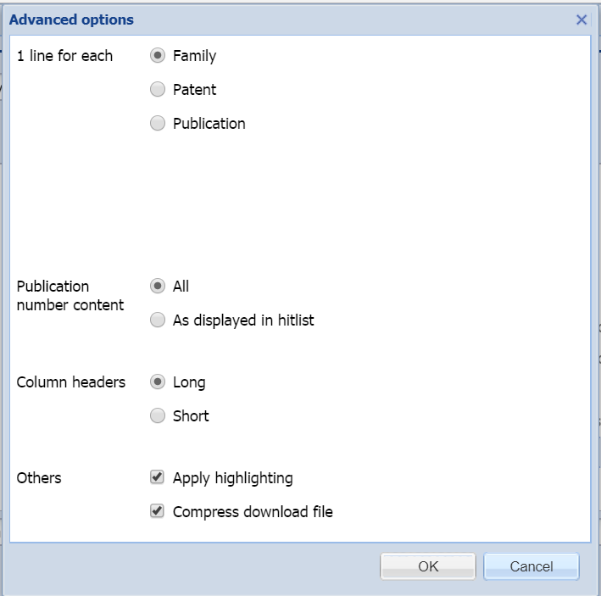
Save
New Export Menu
XLSX

Slide 27
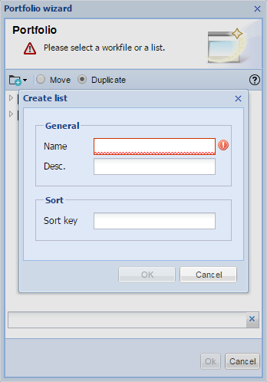
Save
Lists
Related to the search module
Allows to save the results
of one or more searches.
No limit on number of lists
Automatic update of families when the list is opened
Ability to cross the contents of a list with another question
Lists should not be confused with workfiles
Directories are the only ones that can be shared and evaluated.
Workfiles are linked to the folders module

Slide 28
Save
Save search
From the search history or the results list: ability to save search script
or
Script executed manually
No limit on saved searches
Stored in

Slide 29
Exercise 5 Citation tree
Display the citation tree of the patent US9395727
Who is the company citing this document the most?
Notes:
ZOOX

Slide 30
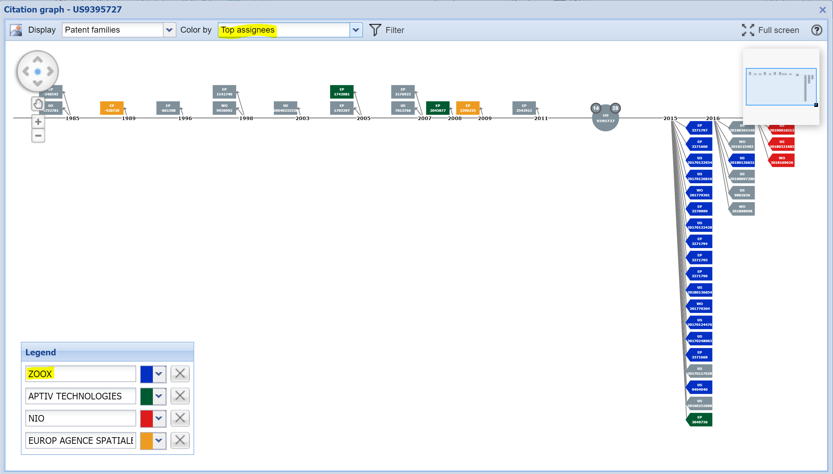

Slide 31
Exercise 6
Who is the parent company of Google?
What is the company revenue of Alphabet?
Notes:
Alphabet

Slide 32
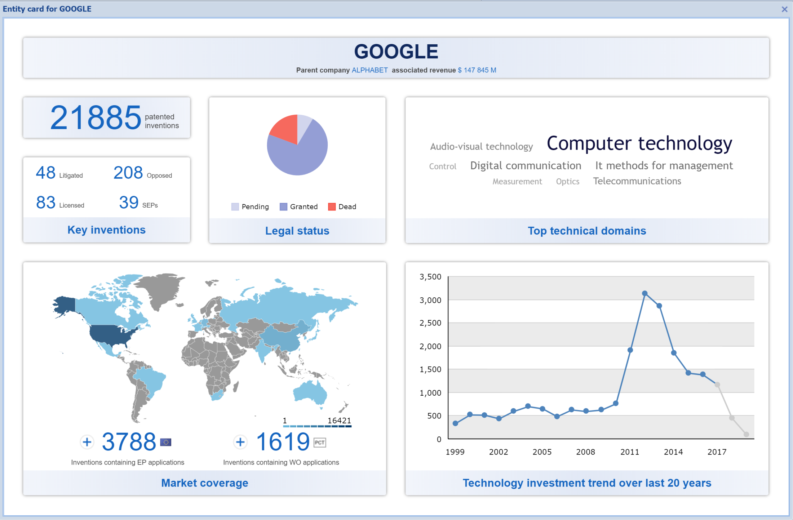

Slide 33
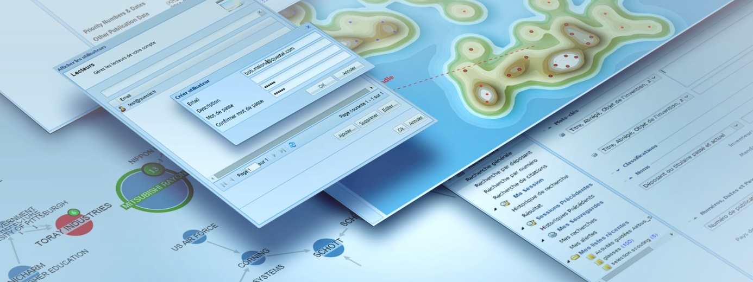
Analytics session

Slide 34
List of features linked to the analysis level
https://www.questel.com/orbit-intelligence-levels/
Analysis level | Essential | Advanced | Premium
Max families in live analysis | 100 000 | 300 000 | 2 000 000
Max families in saved analysis | 15 000 | 20 000 | 30 000
Metrics in analysis | No | No | Yes
Benchmark’s dedicated graphs: plot, tabular, radar | No | No | Yes
Evaluation modules –answer business questions | No | No | Yes
Landscape map | No | No | Yes
Custom axis | No | No | Yes
Export all data | No | No | Yes
Filter | No | Yes | Yes
Browse selection | No | Yes | Yes
Drill down | No | Yes | Yes
Multiple selection | No | Yes | Yes
Color by | No | Yes | Yes
Graph templates | No | Yes | Yes
Concepts analysis | No | Yes | Yes
Cloud chart | No | Yes | Yes
Data rules | Yes | Yes | Yes
Simple selection | Yes | Yes | Yes
One click report | Yes | Yes | Yes

Slide 35
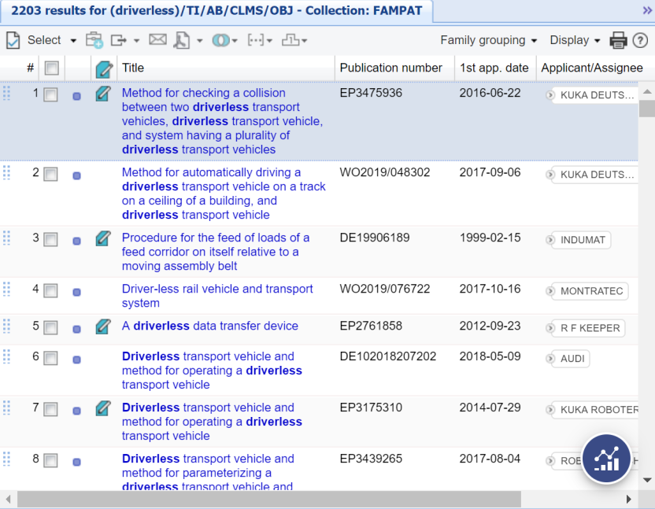
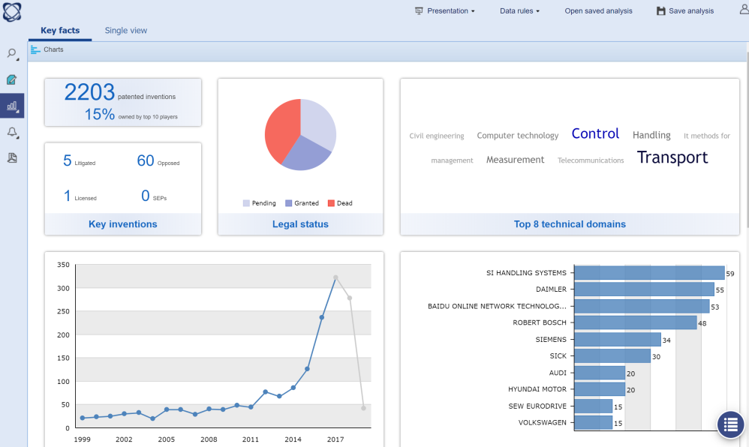
Analyze patent family instantaneously
100,000
300,000
2,000,000

Slide 36
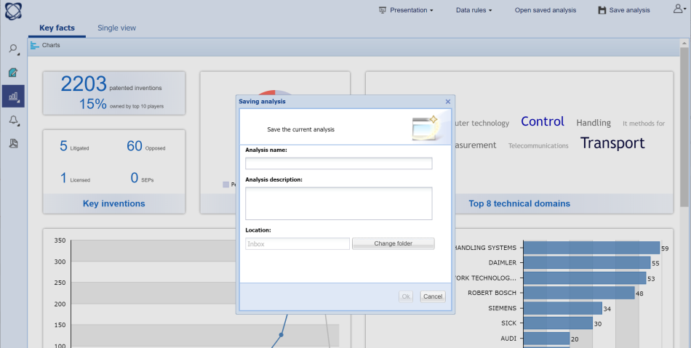
Save and Archive patent analysis
15,000
20,000
30,000

Slide 37
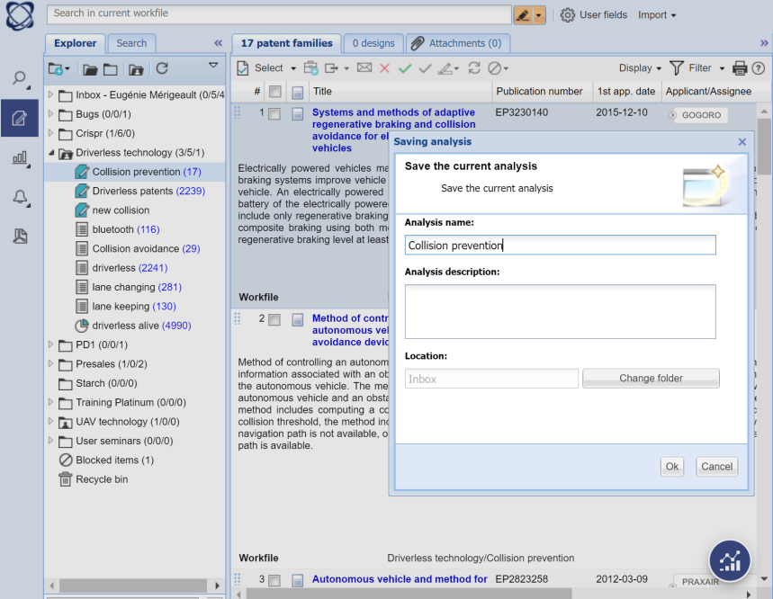
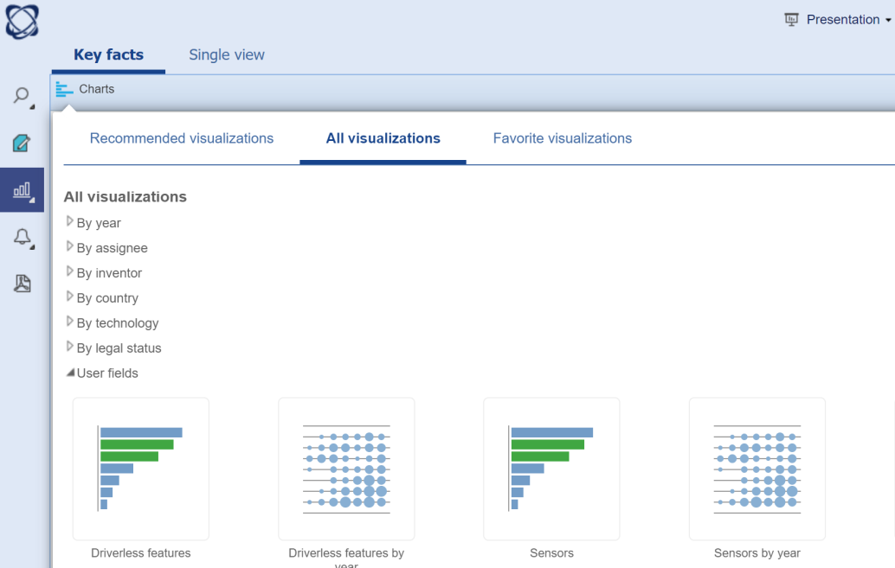
Analyze Workfiles, including user fields
15,000
20,000
30,000

Slide 38
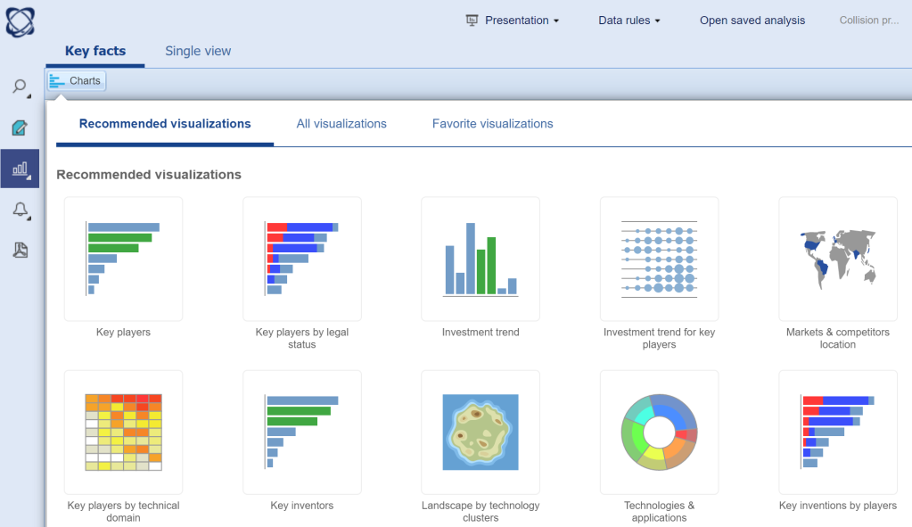
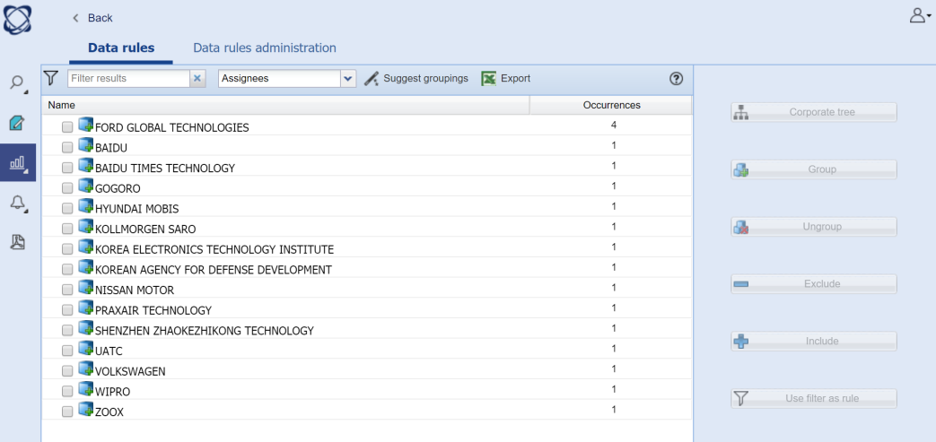
Create data rules (saved analysis)
Yes
Yes
Yes

Slide 39
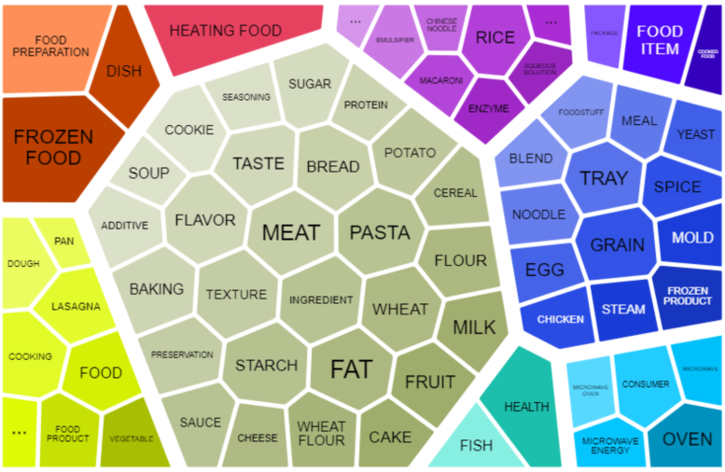
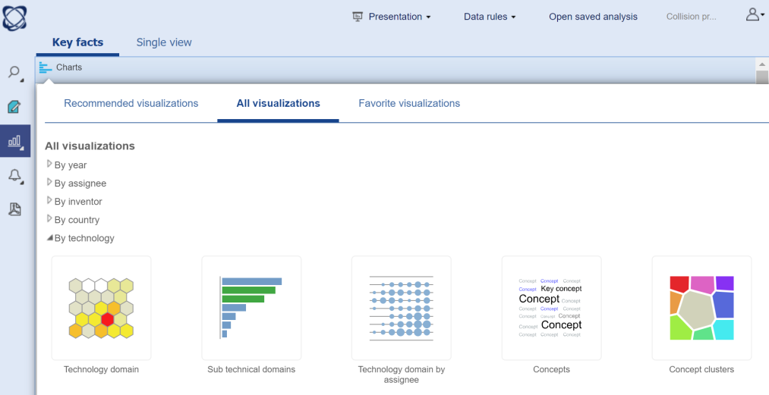
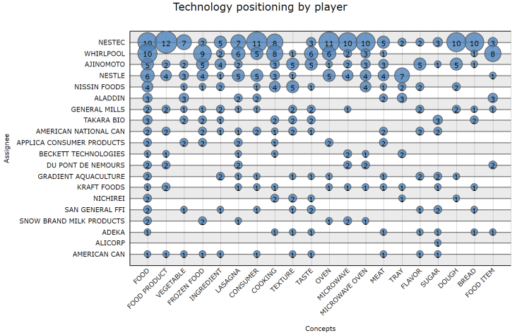
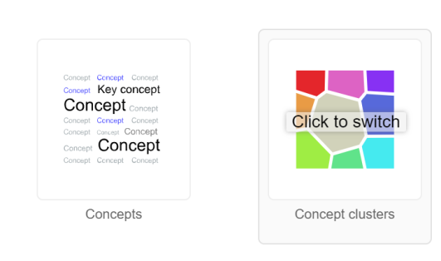
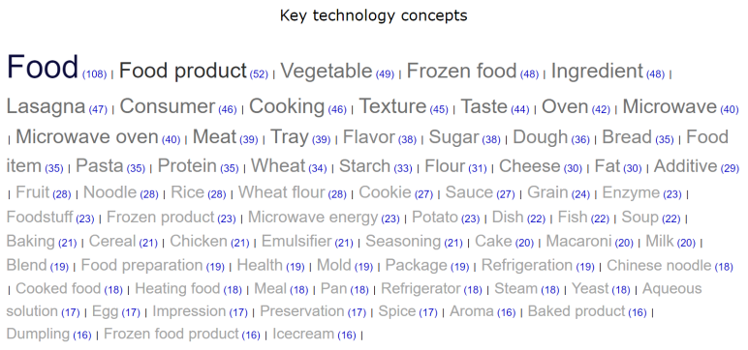
Concepts analysis
No
Yes
Yes

Slide 40
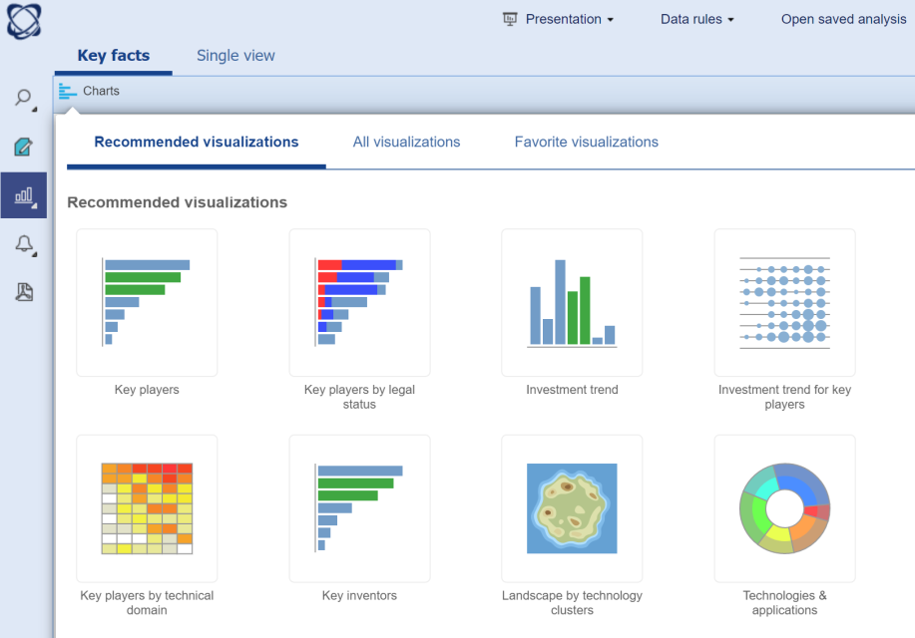
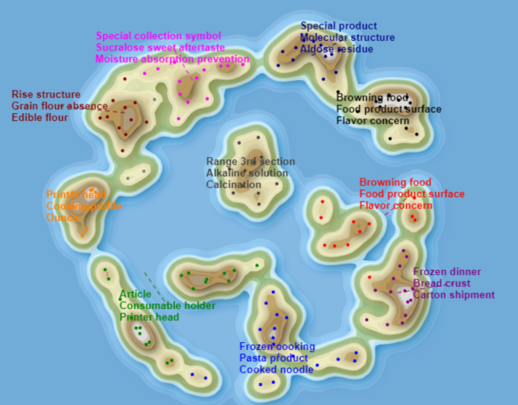
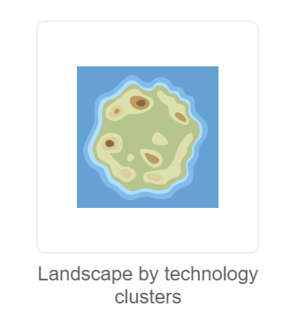
Landscape map
No
No
Yes

Slide 41
Simple selection
Yes
Yes
Yes

Slide 42
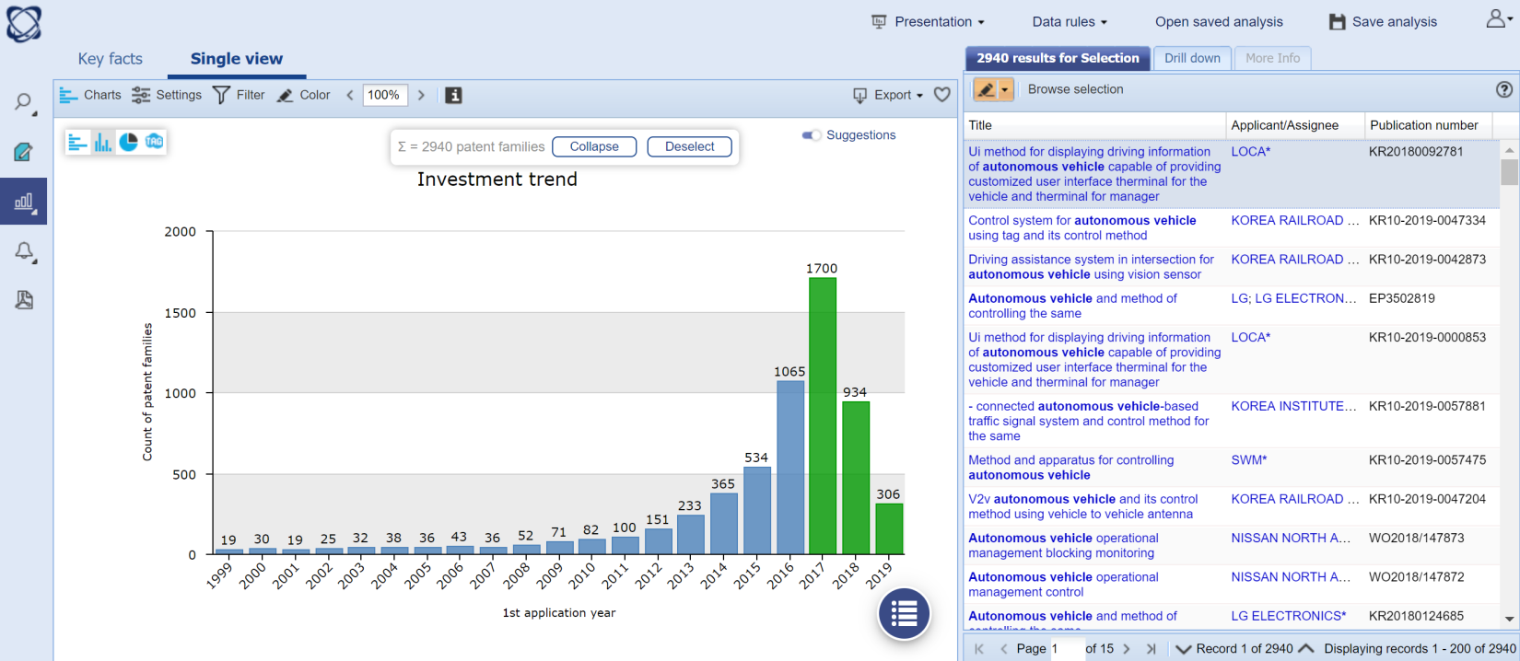
Multiple selection
No
Yes
Yes

Slide 43
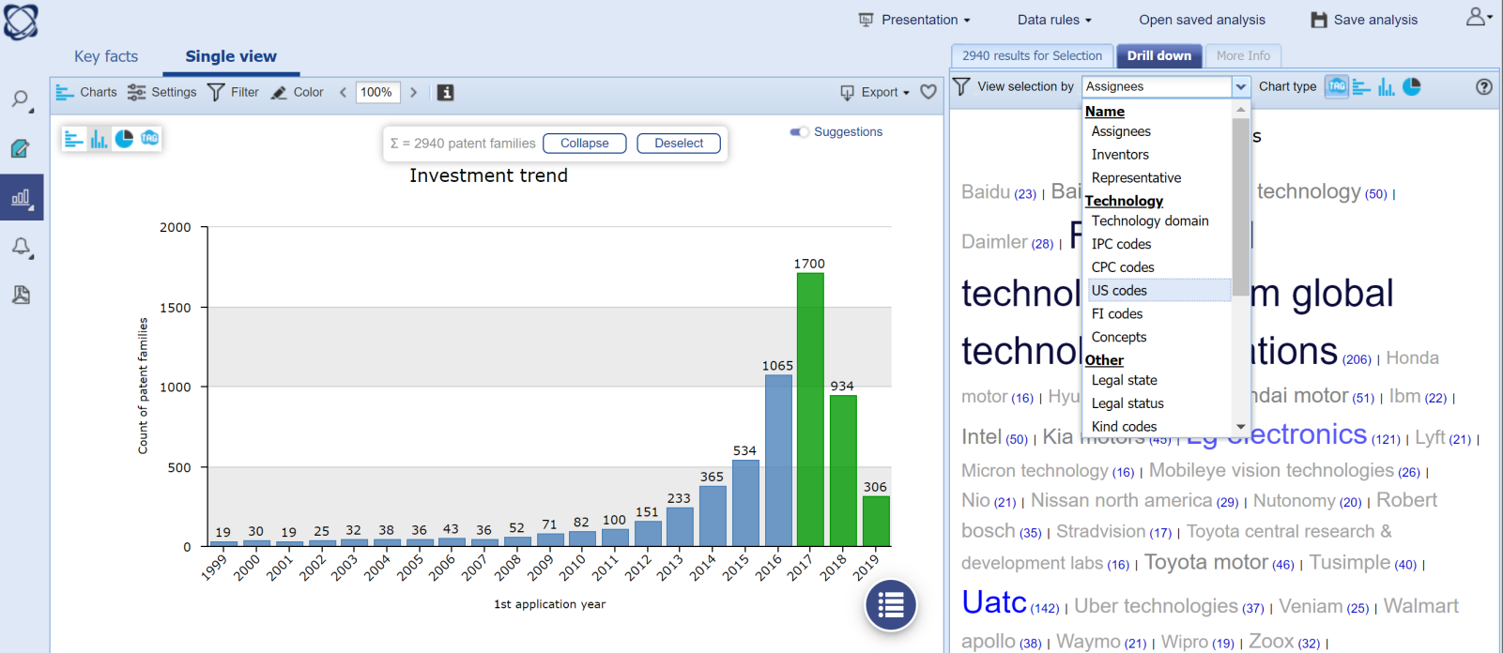
Drill down
No
Yes
Yes

Slide 44
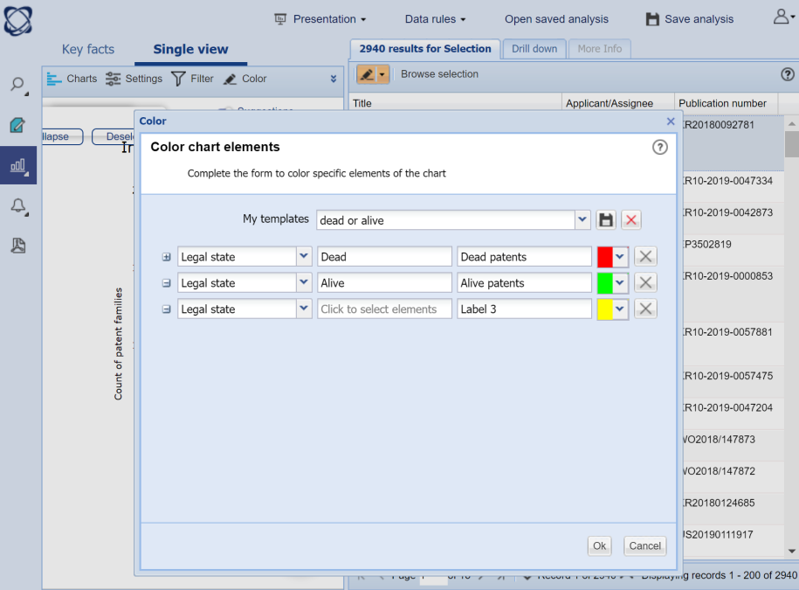
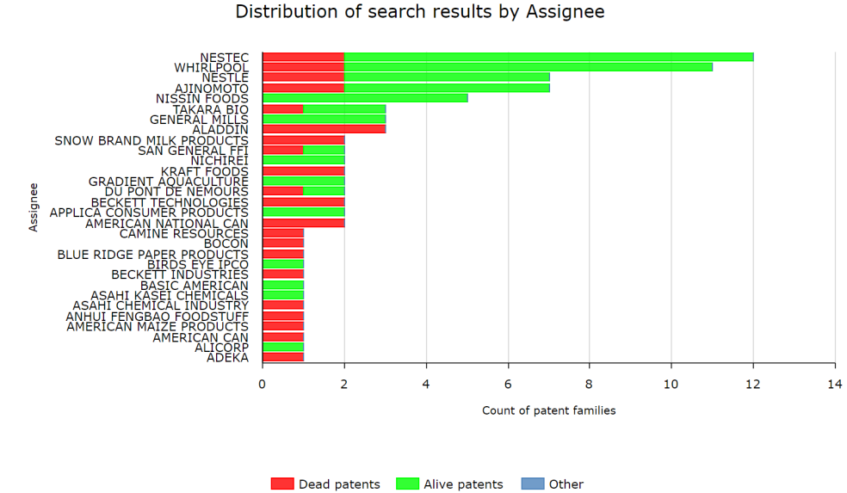
Color by (including lists or workfiles)
No
Yes
Yes

Slide 45
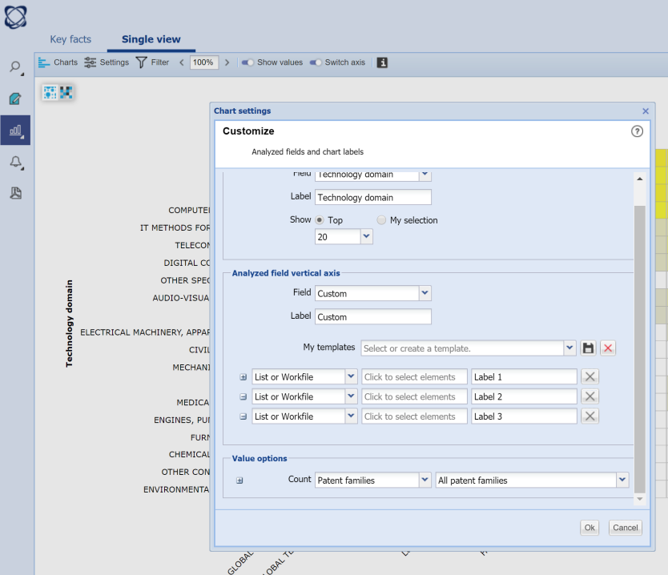
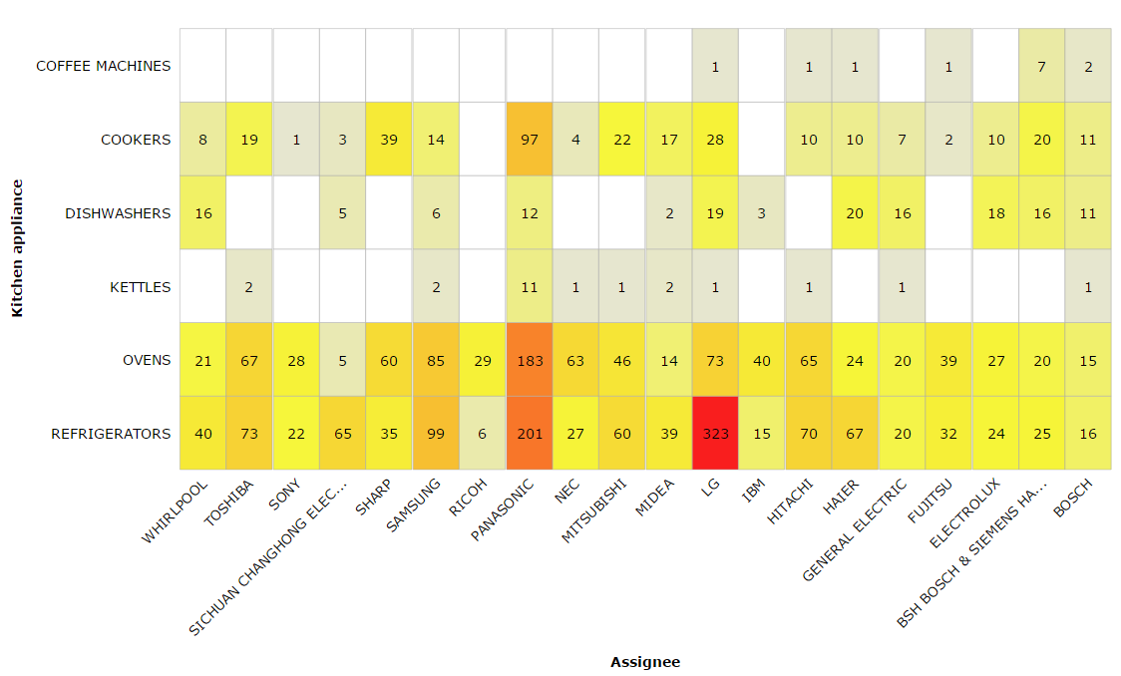
Custom axis
No
No
Yes

Slide 46
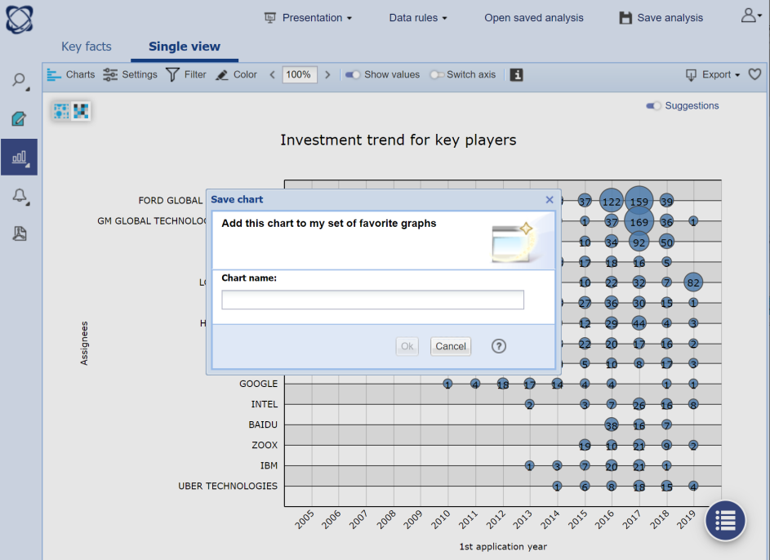
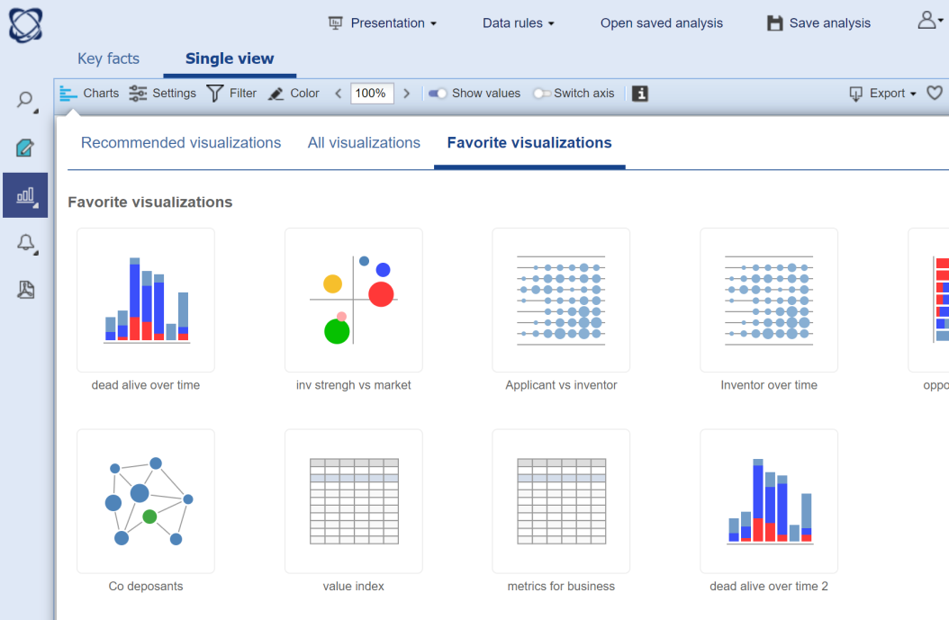
Save chart templates
No
Yes
Yes

Slide 47
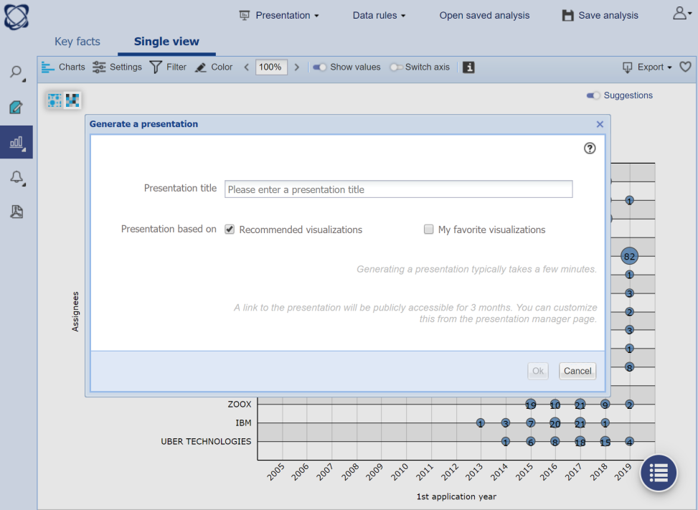
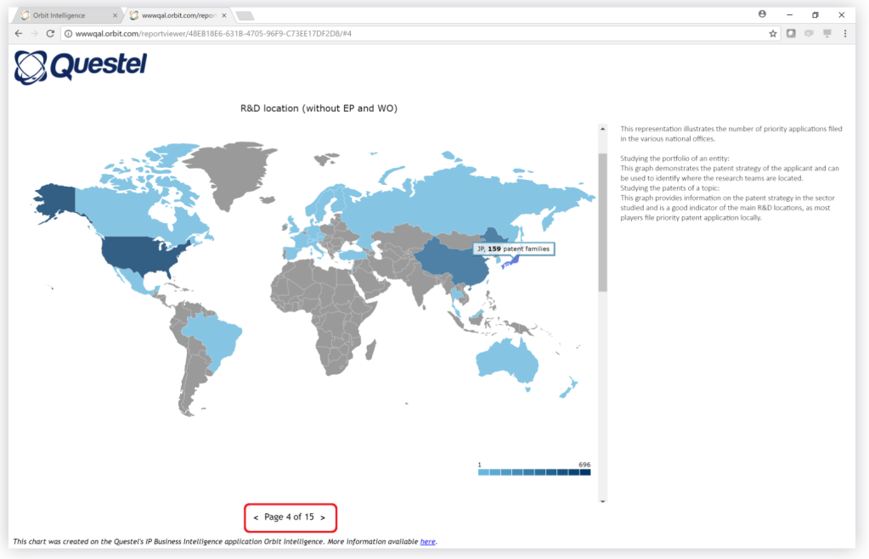
One click report + automatic description
Yes
Yes
Yes

Slide 48
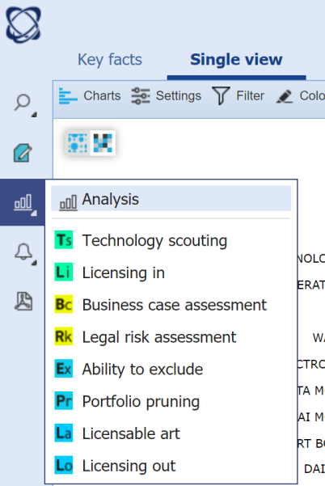
Answer business questions
Evaluation modules
Metrics in the analysis
No
No
Yes

Slide 49
Key metrics in analysis
No
No
Yes

Slide 50
New charts for better benchmarks
No
No
Yes

Slide 51
Patent Impact, Portfolio Value, Estimated Cost, Company revenue
No
No
Yes

Slide 52
Analytics session Metrics explanation

Slide 53
Orbit Intelligence
New patent metrics
All available in live
Platinum only
Impact << Avg patent now has a score of 1
Market strategy << Dead countries now included if granted
Patent strength << Available for dead patent families
Patent value << Score reduced by remaining life factor
Portfolio value << Sum of patent value

Slide 54
Market Strategy Index
Portfolio
US
US
US
US
Family B
Market Strategy : 0.6
Family C
Market Strategy : 1
Family A
Market Strategy: 1
EP
DE
ES
WO
AT
GB
EP
Family E
Market Strategy : 0.23
IT
EP
WO
US
FR
DE
Family D
Market Strategy : 0.65
Family G
Market Strategy : 1.21
Family F
Market Strategy : 0.59
EU Granted/PCT Lapsed
Alive - Granted
Alive - Pending
Dead
The size of the market in the countries where patents are pending or have been granted
(size calculated using GDP)
A reduction of 40% is given to pending countries.
WO/EPs figures are calculated based on the countries where WO/EPs tend to be granted.
Countries where patents where granted but are now dead are included.
Granted but now dead.

Slide 55
Technical impact
Technology Impact Index
2000
A
G
Technical Impact A: 1.72
Technical Impact G: 0
The Technical Impact is based on forward citations which are adapted depending on the nature of the citation (self/non-self), the age, and technical domain of the patent.
LOG progression has also been used to model the increase of a patent’s impact. In other words, the 1st citation increases the impact more than the 101st citation.
Results are normalized so that the average patent has a score of 1.
2010
F
B
D
E
Technical Impact E: 1.9
Technical Impact B: 2.3
Technical Impact D: 0.6
Technical Impact E: 2.61
2015
H
C
Technical Impact H: 0
Technical Impact C: 3.65
Microstructure & Nanotechnology
Chemical Engineering
Civil Engineering
Self Citation
Non-self Citation

Slide 56
Patent Strength Index
Technical Impact
Patent Strength index
Market Strategy
The patent Strength is based on Technical impact and Market strategy.
They are weighted and summed. The weight values have been calculated in order to give high scores to patents which have been litigated.
Patent strength is available for both alive and dead patents.
Results are normalized so that the average patent has a score of 1.

Slide 57
Patent Value Index
Patent Strength index
Remaining
Life
Patent Value index
X
=
Portfolio Value index
The patent value is based on the Patent Strength index with a weighting based on the remaining life of the patent.
Patent value is available only for alive patents.
The Portfolio Value is based on the sum of Patent Value Indexes.

Slide 58
Examples

Slide 59
Examples

Slide 60
Examples

Slide 61
Examples

Slide 62
Workfiles session

Slide 63
Why use the workfiles?
The Workfile is defined by four uses:
Archive: archiving patent families and designs
Review: additions of stars, notes, attachments personal fields
Share: creation of Group readers
Operate: integrated module search, analysis module available

Slide 64
Archive
Directories and folders
A directory can contain subdirectories or folders
A workfile can contain patent families or designs
Sharing is only done at the level of directories
Inbox: directory by default, can not be shared
Lists should not be confused with workfiles
Directories are the only ones that can be shared and evaluated.
Workfiles are linked to the folders module
Workfiles are static, except manual updates or alert feeds

Slide 65
Creation of the tree from the search module via Explorer or from the workfiles module
Search Module:
Workfile Module:
1st step 2nd step
Archive
Directories and folders
Under directory
Directory
Optional

Slide 66
Archive
Feed
Feed of the patent families from the search module (search, list or alert) or from Workfile module (import N°)
Limit number families in contractual records
A family or a designs can be in multiple folders
The tag NEW on a family is present for a week.
Search
Import Numbers
Workfiles
List
Alerts

Slide 67
Archive
Search feed
Feed from an existing folder or create a new folder
Workfile accessible from Explorer
Selection of the directory if not Inbox by default

Slide 68
Archive
Feed by list
Feed from an existing folder or create a new folder
Workfile accessible from Explorer
Selection of the directory if not Inbox by default

Slide 69
Archive
Feed by an alert
Only one directory can be selected.
The Workfile will be created during the 1st run of the alert, the folder will be the name of the alert
An alert can not be sent in an existing folder.
Update of the families in a Workfile if monitoring code UE or QW

Slide 70
Archive
Feed by Number
import
From Workfile module
Select a Workfile

Slide 71
Review
Stars
From 0 to 5 stars
Star(s) assigned to a family
Last distribution of stars displayed
Allocation of the same number of stars to selected families
The stars are exportable and filterable.

Slide 72
Review
Notes
Note (s) assigned to a family
Compilation of attributed notes
Possibility to modify and/or delete
Allocation of the same notes to selected families
The notes are exportable, filterable and searchable.

Slide 73
Review
Attachments
Allocation of the attachment to a family (8 max) or a Workfile (8max)
Attachments are searchable.

Slide 74
Review
Personal fields: creation
Need to define the list of values
100 user fields max
1 single type of field internal classification
Internal classification/ multi-values selector: multiple values per field
Single value selector: one value per field
User fields are exportable, filterable and searchable.

Slide 75
Review
Personal fields:
allocation
Allocation of one or more personal fields to a family
Allocation of one or more personal fields to a selection of families

Slide 76
Share
Readers and Experts
Email address and password are the identifiers for readers to access to the interface Workfiles and to share documents
Associate a reader or an expert with a directory

Slide 77
Operate
Filter
Filter a folder or directory
Filter is deleted when viewing another folder
Filter Active

Slide 78
Operate
Research
Selecting a folder, a directory or the entire portfolio
Different types of data usable for search.
Unwanted items and trash are searchable only.

Slide 79
Operate
Update
Update of selected families
Update the contents of the families: new members, new information etc...
Tag updated is present on the family for a week.

Slide 80
Settings
Account button then
Preferences on display include: number of results per page, mail notification, etc...

